Slide 1


2019 MEASLES UPDATE
Presented by
Barbara Keller RN/PHN BSN CIC
Updated 3.27.2019

Slide 2
MEASLES UPDATE
Objectives:
Name 2 current U.S. locations of Measles Outbreaks
Preferred lab testing methods for Measles
Reporting to Public Health – 24/7!
Public Health resources available to you

Slide 3
Measles Vaccination
CDC recommends all children get two doses of MMR (measles-mumps-rubella) vaccine
  1st dose: 12 through 15 months of age
  2nd dose: 4 through 6 years of age
MMR Vaccine Effectiveness: Two doses of MMR vaccine are 97% effective at preventing measles
Herd Immunity: World Health Organization (WHO) currently recommends that on a national basis at least 95 percent of children are immunized against diseases targeted for elimination or control.

Slide 4
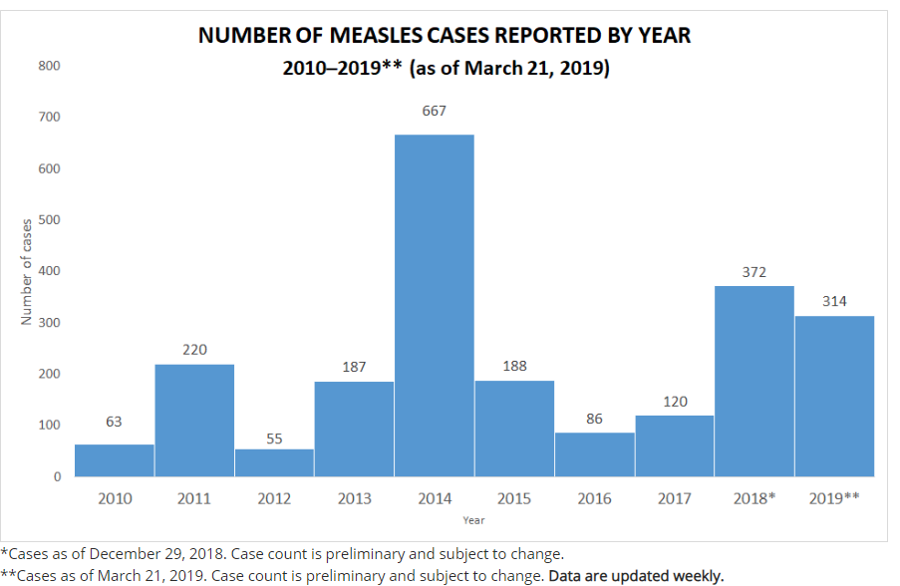
MEASLES: U.S. Cases Reported
Cases in: California, Colorado, Connecticut, Georgia, Illinois, Kentucky, New York, Oregon, Texas and Washington.
Source: Morbidity and Mortality Weekly Report (MMWR), Notifiable Diseases and Mortality Tables(https://www.cdc.gov/mmwr/publications/index.html)

Slide 5
MEASLES OUTBREAKS
6 Current Outbreaks in the United States (CDC)
(as of 3/27/19)
Washington & Oregon:
  Clark County and King County (WA)
  Multnomah County (OR)
Tri-State Area (East Coast):
  New York State (Rockland County), New York City (Brooklyn) and New Jersey (Ocean and Passaic County)
Texas: 14 confirmed cases
California: 7 confirmed cases
NOTE: All the communities affected have clusters of unvaccinated people. Some States allow vaccine personal exemptions.
In 2019, the WHO added ‘Vaccine Hesitancy’ to the list of 10 threats to global health.
SOURCE: https://www.who.int/emergencies/ten-threats-to-global-health-in-2019

Slide 6
MEASLES OUTBREAKS
Current Outbreaks
Washington State:
  Clark County (Vancouver area) and King County (Seattle area)
  Hotspot community of non-medical vaccine exemptions among school aged children
  Status: ONGOING since January 2019 - Updated 3/27/19
  King County: 1 confirmed case (no new cases since 1/23/2019)
  74 confirmed cases 0 Suspect cases
    63/73 Clark County residents were unvaccinated
    3 cases received 1 dose of MMR vaccine
    7 cases, immunity could not be verified
    Transmission to other States: Georgia, Hawaii and Oregon
    March 18th was the last confirmed case
  Oregon State: Status: UPDATED 03/26/19
  Multnomah County
  4 confirmed cases: No new cases linked to Clark Co. since 2/7/19
NOTE: All of the measles cases in this outbreak have been traced to the same wild strain of the measles virus from the Ukraine
Notes:
Clark County is across the Columbia River from Portland Oregon. Washington State has many anti-vaccinators.
Statistics for these outbreaks updated _____________
Washington – 2019 Outbreak Updates: https://www.doh.wa.gov/YouandYourFamily/IllnessandDisease/Measles/MeaslesOutbreak
Oregon – 2019 Measles Updates: https://www.oregon.gov/oha/PH/DISEASESCONDITIONS/DISEASESAZ/Pages/measles.aspx

Slide 7
MEASLES OUTBREAKS
Current Outbreaks (cont.)
Tri-State Area (East Coast):
  New York State (Rockland County), New York City (Brooklyn) and New Jersey (Ocean and Passaic County)
  Cases occurred primarily among unvaccinated people in Orthodox Jewish communities and associated with travelers who brought measles back from Israel, where a large outbreak is occurring.
  Status: ONGOING since October 2018 – Updated 03/27/19
  408 confirmed cases
    New York State (Rockland County): 153 cases – Updated 03/27/19
      Rockland County declared state of emergency. 30 day ban on any unvaccinated people under the age of 18 from public gathering places: schools, churches, civic centers, shopping malls, restaurants, etc. (50% of cases 18 and under)
    NYC (Brooklyn): 214 cases – Updated 03/27/2019 (31 new cases this week)
    New Jersey: 33 cases (had resolved in 1/2019)
    New Jersey: 6 new cases in March (Updated 3/22/2019)
Note: In 2018, CDC reports that 81 people brought measles to the U.S. from other countries. This is the highest number of imported cases since measles was eliminated from the U.S. in 2000.
Notes:
Statistics for these outbreaks updated _____________
2018/19 Outbreak Updates:
New York State (Rockland) -
http://rocklandgov.com/departments/health/measles-information/
NYC -
https://www1.nyc.gov/site/doh/health/health-topics/measles.page
NJ –
https://www.state.nj.us/health/cd/topics/measles.shtml#4

Slide 8
MEASLES OUTBREAKS
Illinois State: Champaign-Urbana (4 Cases)
(as of 2/19/19)
  Two students at the University of Illinois campus
  Both students were not vaccinated
  Case #1: Rash onset January 13th
  Case #2: Rash onset January 31st (had been in a building where the first student was while infectious.
  Two additional cases confirmed. One was identified as a contact and in home isolation during the incubation period.
Notes:
Champaign-Urbana Public Health District (CUPHD)
Press release 02/04/2019 –
http://www.c-uphd.org/press-release-item.html?item=407

Slide 9
Measles Worldwide
1/21/2019: During the week ending January 19, 2019, the CDC (Center for Disease Control), PAHO (Pan American Health Organization), and WHO (World Health Organization) reported significant increases in measles cases with ongoing Outbreaks in various countries in 2019 such as Israel, Italy, France, and the United Kingdom.
Measles common disease in many parts of the world, including Europe, the Middle East, Asia, the Pacific and Africa.

Slide 10
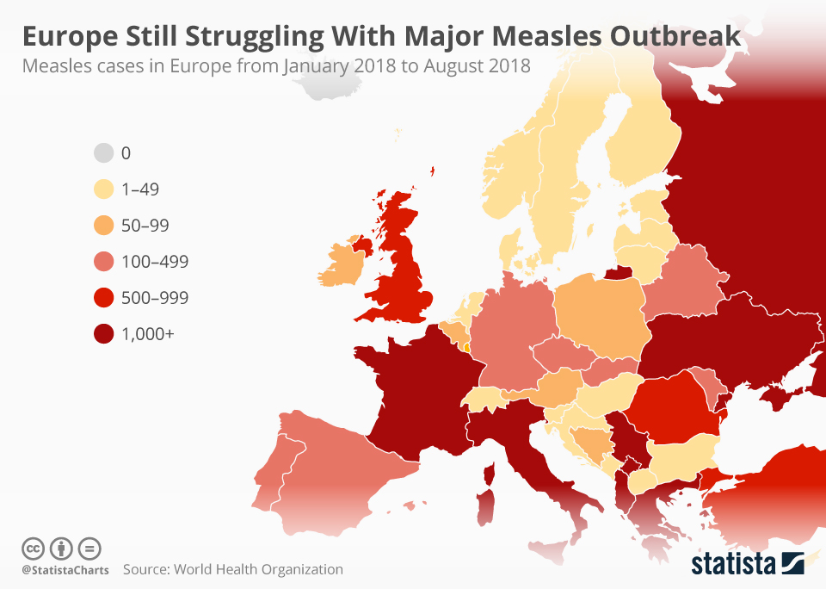

Slide 11
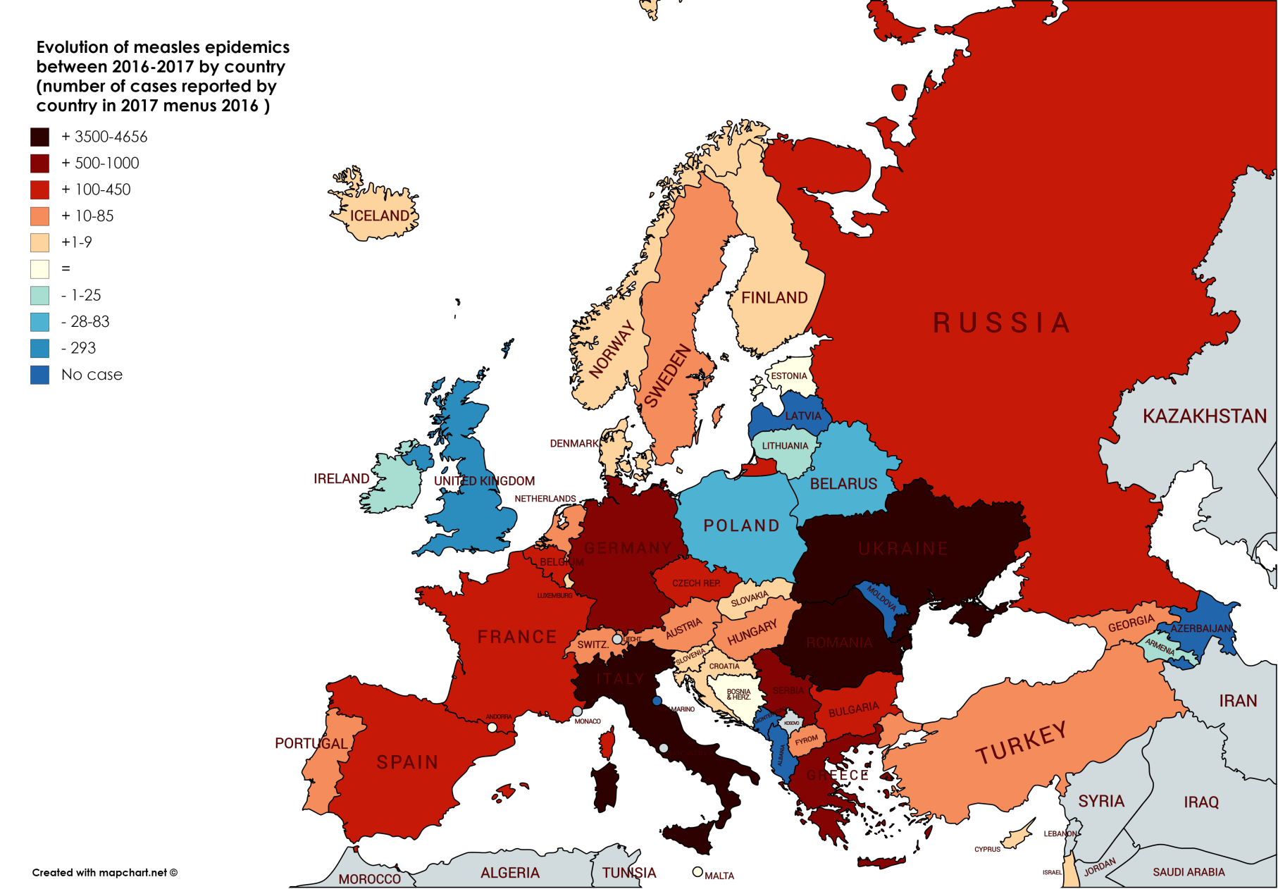

Slide 12
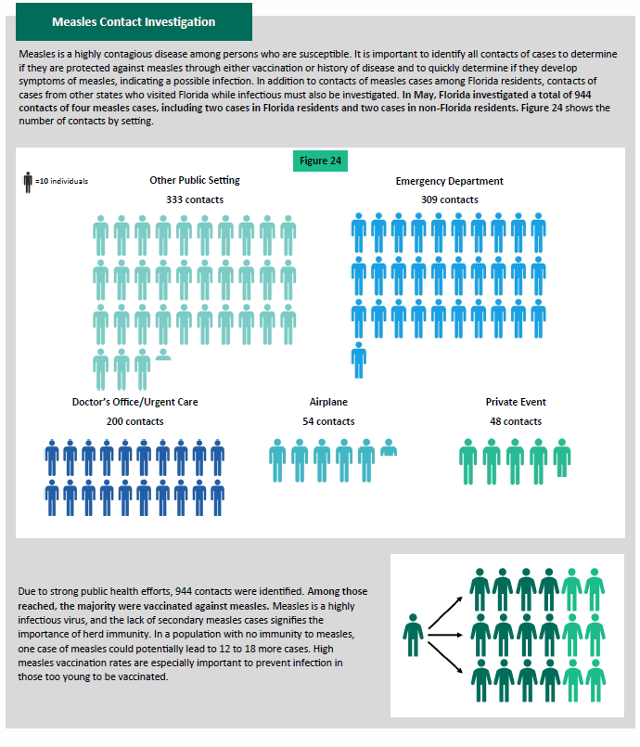
Published by Florida Department of Health
May 2018
4 cases of Measles
944 contacts
1 case could potentially lead to 12-18 more cases
SOURCE:
http://www.floridahealth.gov/diseases-and-conditions/vaccine-preventable-disease/measles/_documents/surveillance-summaries/2018-may-measles-summary.pdf
Notes:
Demonstates the number of contacts required for only 4 cases of measles.

Slide 13
Measles: Transmission
Highly contagious – one of the most contagious of all infectious diseases.
Virus transmitted by infectious droplets when an infectious person breathes, coughs, or sneezes. (Airborne Isolation)
Measles virus can remain infectious in the air.
Up to 2 hours (CDC); 1 hour (CDPH)

Slide 14
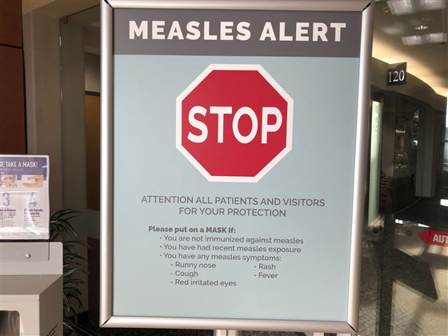
Measles: Prevent Transmission
Hospitals: Place all febrile rashes
in Airborne isolation until Measles is ruled out.
Notify Public Health Department
while your case is in the E.D. (24/7).
Work together with Public Health!
PCR testing for Measles through your Public Health Lab
If the case is discharged home..
  Discuss with Public Health before discharge because…
  How will they get home…avoid Public Transportation?
  Suspects should be on Home Isolation until confirmed negative or no longer infectious. Need to consider who they live with. (babies < 1 yr.?; immunosuppressed family?)
    Definition of Home Isolation: Confined to their home and possibly a room in the home. If a house, can not go beyond their property line; apartment – a room
Notes:
The earlier you have the patients masked and isolated – you will decrease risk of transmission and exposures.
Physician offices - if you have a case to evaluate, see end of day and then close off that room for the night. OR.. See in the parking lot. Educate your staff taking appointments, screening calls to plan on when and where suspect cases – end of day? Parking lot? Call Public Health before so you know what you need to collect specimens and get to Public Health Lab?
Important for physicians to be on the same page as Public Health so the patient is hearing the same message. Patients or contacts need to understand the importance of not putting others at risk.
We – physician offices, hospitals and the community need those possibly infectious, confirmed cases and infectious - to stay home – not go to the store, go to the office, pick up kids from school, eat out at restaurants, etc.

Slide 15
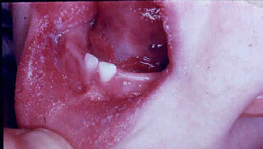
Measles: Clinical Presentation
Prodrome – onset 8-12 days after exposure
(range = 7-21 days)
High Fever – 101˚ F or higher.(May spike to 105˚F or >)
Cough, Conjunctivitis, and/or Coryza (runny nose/nasal congestion
Koplik spots

Slide 16
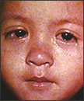
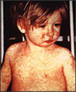
Measles: Clinical Presentation
Rash begins 2-4 days after prodrome
Maculopapular rash
Eyes of a child with measles
Begins on face and head, then descends down to trunk, arms and legs
Measles – what’s
the big deal?
Child with a classic
Measles rash after four days

Slide 17
Measles Complications
People at the highest risk of complications?
Age: Children under 5 years (especially <12 months)
Adults > 20 years
Pregnant women
People with compromised immune systems i.e. leukemia, HIV infection, undergoing chemo therapy

Slide 18
Measles Complications
Common Complications
Otitis Media (1/10 can have permanent hearing loss)
Bronchopneumonia, laryngotracheobronchitis (can trigger reactive airway disease)
Diarrhea
Serious complications/illness in children
1/1000 children will develop acute encephalitis, which can result in permanent brain damage
1-2/1000 children who become infected with measles will die from respiratory and/or neurologic complications.
Subacute sclerosing panencephalitis (SSPE) is a rare, but fatal degenerative disease of the central nervous system that generally develops 7-10 years after measles infection.

Slide 19
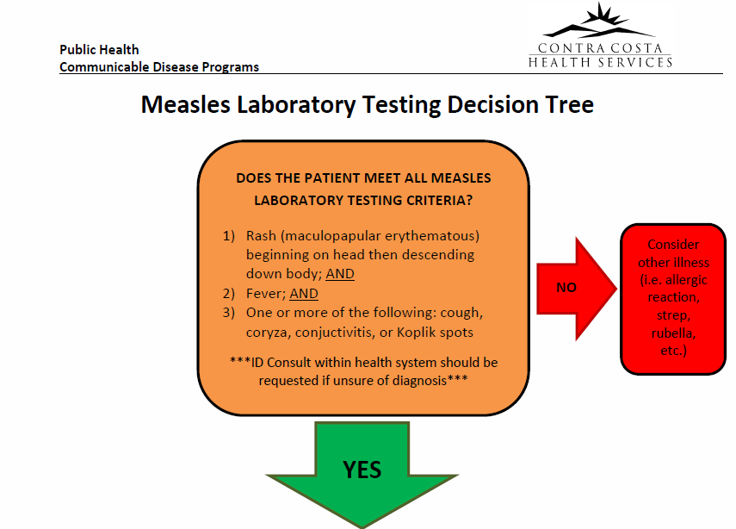

Slide 20
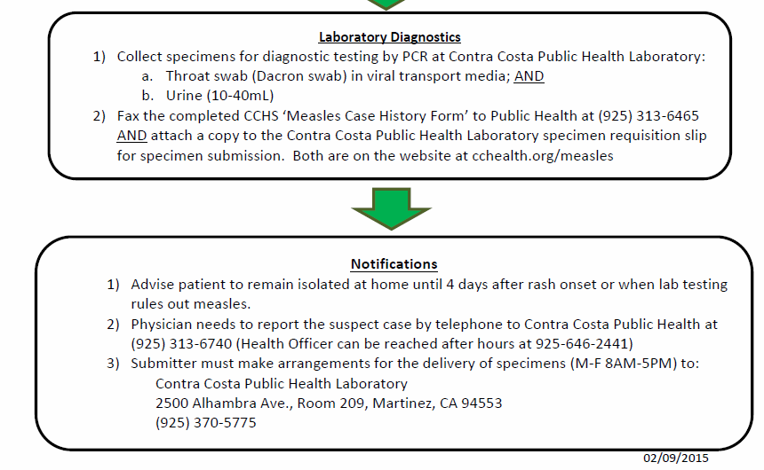

Slide 21
Risk Factors for Measles
3 Weeks Prior to Onset:
  Travel outside of North America
  Transit through U.S. International Airports
  Interaction with foreign visitors
  Visited a U.S. tourist attraction
Any known contacts diagnosed with Measles
  Lab confirmed?
  Testing the contact?
Immunization status of the patient
Notify Public Health if you are considering measles in your differential diagnosis
Public Health will assist in determining immunity in your contacts.

Slide 22
MEASLES
Contact Public Health 24/7
Main Number: 925-313-6740
After Hours/Weekends:
  Sherriff’s Dispatch: 925-646-2441
    ** Ask for the Health Officer on call
Notes:
County Sheriff Dispatch ask for Health Officer On-Call

Slide 23
Measles: Contacts/ Exposures
Time Sensitive:
Identify sites of exposures in healthcare and community (Public Health and Hospitals partner)
Identify high risk exposures:
  Infants (<1 year of age)
  Pregnant women with no immunity
  Severely immunocompromised persons, irrespective of evidence of measles immunity
  Health care workers w/ no evidence of immunity
    (furlough from work day 5 from the first day exposed;
    Through day 21 from the last day of exposure)

Slide 24
Measles Exposures: Clock is ticking
Post Exposure Prophylaxis (PEP)
The administration of MMR or IG as PEP to exposed contacts depends primarily upon time since exposure, age of contact, and risk status of the contact.
MMR Vaccine for PEP: May be given <72 hours after LAST exposure to susceptible persons >OR = to 6 months of age.
Immune Globulin (IG) for PEP: IG may be given to exposed susceptible people (and severely immunocompromised persons, regardless of immune status) < or = 6 days from last exposure to prevent infection.
NOTE: Effectiveness of IG PEP varies based on the nature of exposure, dosage, and type of IG administered, etc.
Quarantine Susceptible persons: Contacts With No Immunity or Unknown Immunity – who did not receive timely post exposure prophylaxis (next slide an example of Quarantine Order Public Health Department would serve)

Slide 25
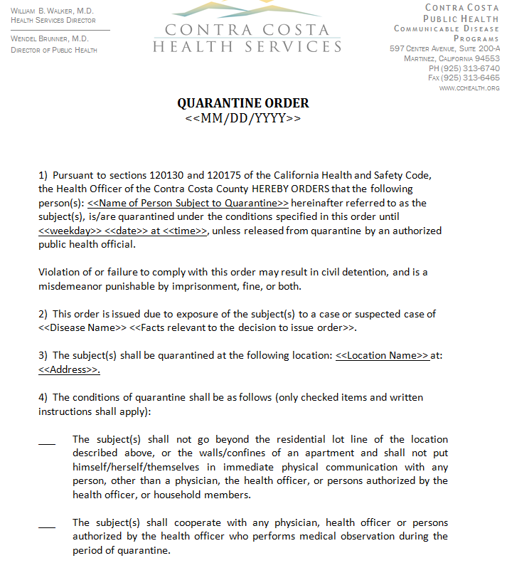

Slide 26
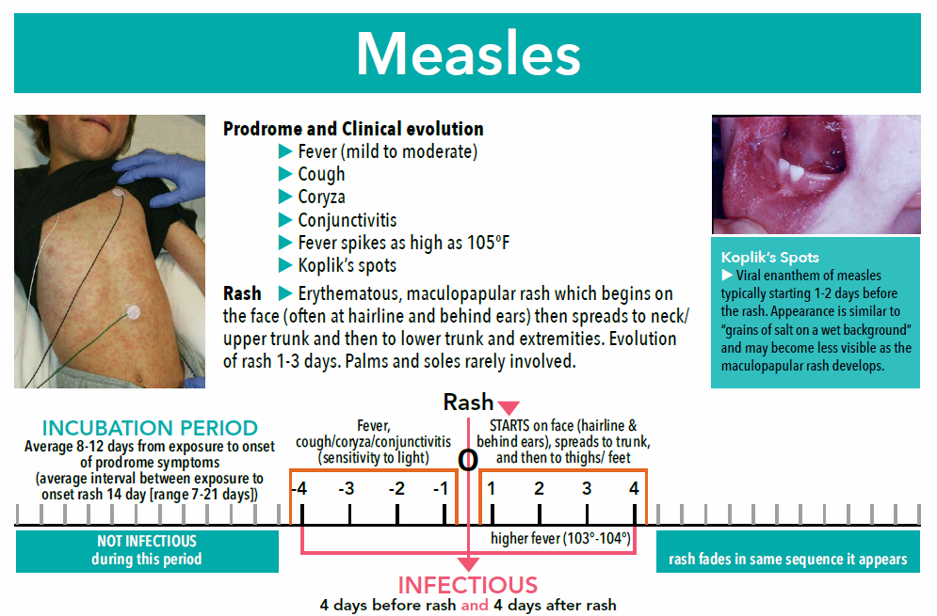

Kaiser Permanente diagnostic tool and it is posted on Contra Costa County Public Health Measles website.

Slide 27
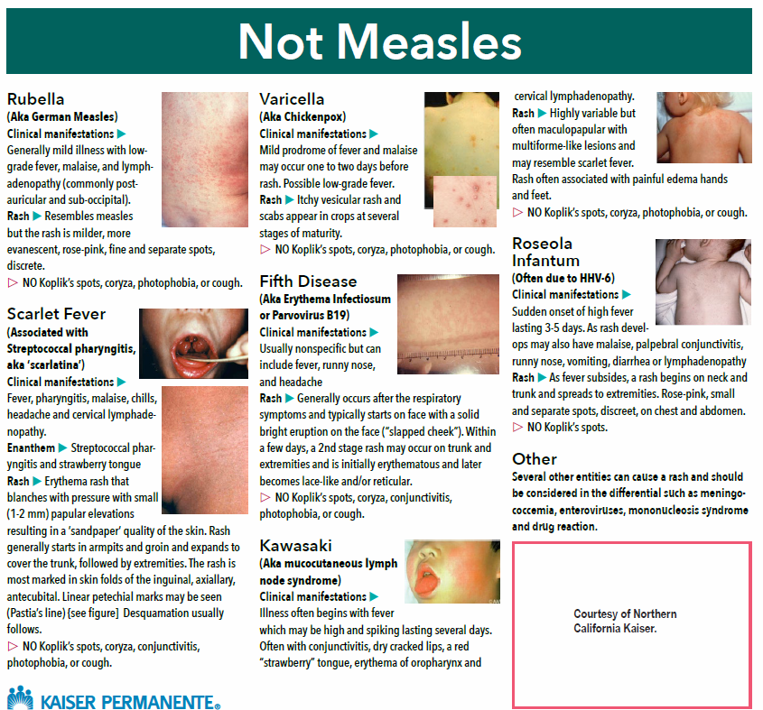

Slide 28
Measles: Lab Testing
Symptomatic
COORDINATE DIAGNOSTIC TESTING WITH YOUR PUBLIC HEALTH DEPT
(NOT a commercial or send-out laboratory)
PCR diagnostic testing preferred through Public Health Lab. PCR has faster turn around times and Public Health will work with their Lab to prioritize.
  *** Public Health Labs - some will work on weekends for Measles cases.
  DO NOT submit specimens to a Public Health Lab w/out first notifying or consulting with your local health department.
Specimen collection: Collect BOTH
  Throat swab (Dacron swab) in viral transport media; AND
  Urine (100-400ml)
  (Know the process for your Public Health Lab)
Fax the completed CCHS ‘Measles Case History’ form to Public Health @ 925-313-6465.
County Public Health Labs complete preliminary testing for diagnosis and then forward on to the State Laboratory (CDPH-MDL) for genotyping

Slide 29
Measles: Lab Testing
Other Testing Methods
Serology: recommend acute and convalescent titers - requires additional time
Serum measles IgM antibody –
  false negatives and positives can occur
Viral Cultures: Can take up to 14 days

Slide 30
Measles Immunity?
Contact Investigation:
Public Health will assist in criteria to assess immunity during Public Health interviews of the contacts (no symptoms)

Slide 31
Measles: Contra Costa County
Case History
Day 1 - Onset: Body aches
Day 4 - Rash onset behind the left ear and then spread down. Red watery eyes, fever 103F and sore throat.
Adult
Case stated: Immunized for Measles but no documentation.
Day 5: Went to the local E.D. for care. Not isolated. Tested for measles
Day 10: Public Health notified after lab confirmation.
Infectious Period: 4 days before rash to 4 days after
Travel during Infectious Period:
  New York, New Jersey, Arizona, Santa Monica
  Exposure sites: Hospitals, Airports, Airline flights, Hotels, restaurants, and many other venues.

Slide 32
Measles: Case Continued
Hospital and Community Exposure Risks
Puts your patients/visitors at risk
Hospital staff exposures
Labor Intensive Contact Investigation:
Waiting room patients/visitors, E.D. staff
  Case went home, no isolation so…… restaurants, grocery stores – still infectious;
    Other Counties visited: Marin County and San Francisco
  Notifications of other States, Counties in California, CDC – airline travel, etc.
  Worked with Public Relations (Hospital and Public Health Media departments)
  Public Health and CDPH assisted as a resource and logistics since multi-jurisdictional

Slide 33
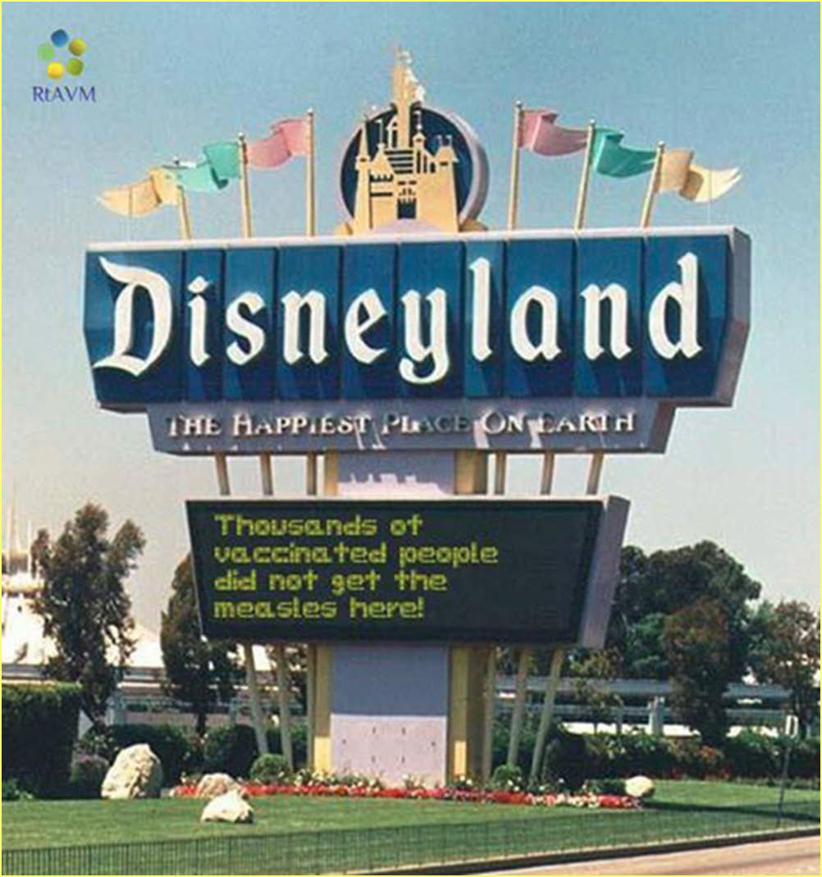
2014-2015 Disneyland Measles Outbreak
CDPH slides

Slide 34
2015: Measles Disney Outbreak
131 Cases (CDPH data)
42 (32%) of the 131 cases were exposed at Disneyland during December 17-20, 2014, a very high reproduction number for one infectious person (measles Ro = 12-18)
31 (24%) cases were household or other close contacts (e.g., boyfriend/girlfriend) of cases
11 (8%) cases were exposed in a healthcare setting; three were healthcare personnel (HCP) exposed at work
  Emergency department: 7
  Urgent care: 3
  Hospital inpatient unit: 1
3 (2%) were exposed in a mall
44 (34%) had unknown exposure setting

Slide 35
2014-2015: Measles Disney Outbreak
CDPH Recommendations for Measles Testing
CDPH recommends PCR as primary diagnostic tool for measles; the state lab and 17 local public health labs offer measles testing
  PCR testing –benefits of PCR include: Virus can be detected from day of rash onset in respiratory specimens (throat swab preferred); <7+ days after rash or urine <10+ days after rash. Contra Costa prefers collection of both throat and urine specimens for PCR
These specimens are easy to collect and are non-invasive
The test is rapid (TAT <1 day)
Additional testing to identify genotype can be performed
  More sensitive and specific than IgM testing IgM testing can yield false positives (rheumatoid factor, pregnancy, etc.)
  IgM negative result in blood collected <72 hours of rash onset cannot be relied upon
  IgM testing can be falsely negative in previously vaccinated persons
During the Disney Outbreak:
  State lab performed 1500 PCR tests
  Local public health labs performed >900 PCR tests AND IgG testing for immunity

Slide 36
Complications: Two Cases from Disney Outbreak
CASE 1:
An adult collapsed at home and was admitted due to severe pneumonia, intubated and ventilated
Multiple organ injury; renal dialysis
Minimally responsive during much of hospital stay
Extubated during the third week of hospitalization
Required physical and occupational therapy
Discharged home after four weeks – still on oxygen and using a wheel chair for mobility; required long period of convalescence
CASE 2:
An adult on high dose steroids was admitted with bilateral pneumonia and subsequently diagnosed with measles. Developed acute respiratory distress syndrome and was intubated
Remained in respiratory failure for several days and was treated with IV ribavirin on an IND protocol
Discharged at day 15 into a rehabilitation program; required a long period of convalescence at home

Slide 37
Measles: Resources
CDPH Web Link for Hospitals and Infection Prevention:
  https://www.cdph.ca.gov/Programs/CID/DCDC/CDPH%20Document%20Library/Immunization/Measles-HCFacilityICRecs.pdf
CDPH Measles Quicksheet:
  https://www.cdph.ca.gov/Programs/CID/DCDC/CDPH%20Document%20Library/Immunization/Measles-Quicksheet.pdf
  CDPH website also has many resources for public and providers
CDC:
  https://www.cdc.gov/measles
Contra Costa County:
  https://cchealth.org/measles
  Each County has their own Measles website with resources and contact information
Arizona State Public Health: Measles Surveillance Toolkit for Healthcare Settings:
  https://www.azdhs.gov/documents/preparedness/epidemiology-disease-control/measles/measles-surveillance-toolkit.pdf

Slide 38
Acknowledgements
Contra Costa Public Health Department, Communicable Disease Section
CDPH, Immunization Branch

Slide 39
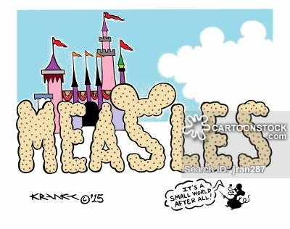
2014-2015: Measles Disney Outbreak
It’s a Small World After All!

Slide 40
Thank you!
QUESTIONS?

